Slide 1

AI in Action: Transforming Instruction in Academic Libraries
Amy James, Online Librarian for Education & Information Literacy
Ellen Filgo, Director of the Liaison Program
April 15, 2025
Notes:
Amy

Slide 2
Objectives
Identify
Identify AI trends and tools in library instruction
Understand how generative AI is being used in higher education and libraries
Recognize key generative AI tools relevant to academic librarianship
Develop
Develop strategies for engaging with AI and library instruction
Explore challenges and opportunities in generative AI adoption, including faculty and student perspectives
Consider ethical implications and best practices for integrating generative AI into instruction
Notes:
Amy

Slide 3
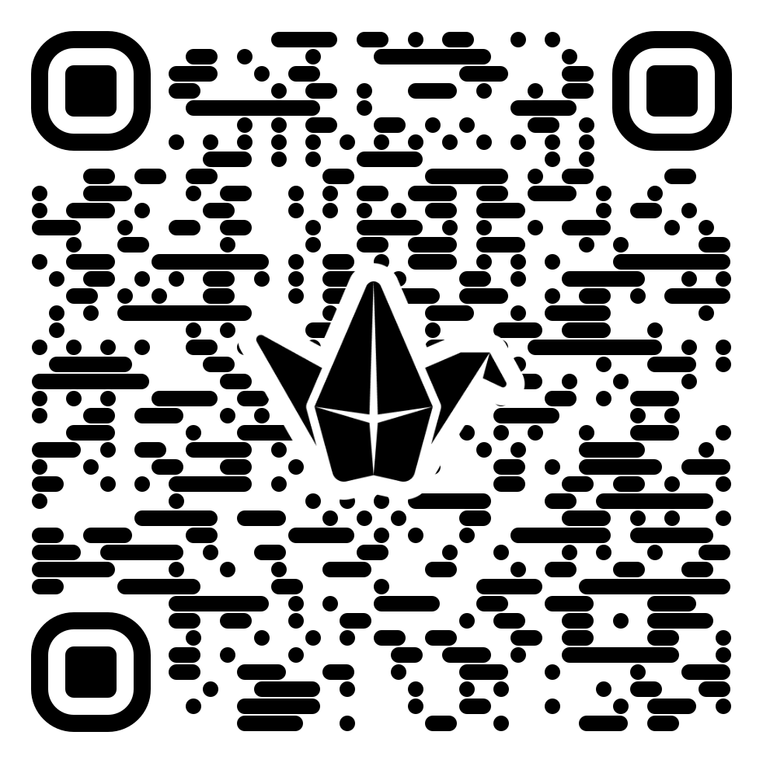
Join our Padlet!
Join with the QR code or at http://tiny.cc/carli_aitalk
Notes:
Amy
Have them answer the first three questions:
How are you using AI?
What lessons have you done?
What tools have you used or what tools has your library subscribed to that incorporate AI?

Slide 4

Attitudes towards AI
Notes:
Ellen
At the beginning, we'd like to zoom out a bit and talk about attitudes towards AI broadly across higher education. There are a few surveys that have come out in the past year or so that can shed some light on this.

Slide 5
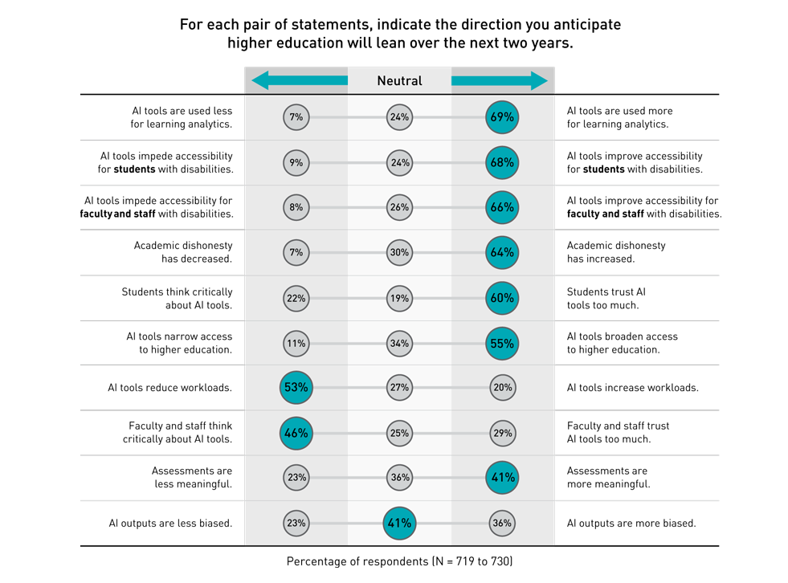
2024 EDUCAUSE AI Landscape Study
https://www.educause.edu/ecar/research-publications/2024/2024-educause-ai-landscape-study/the-future-of-ai-in-higher-education
Notes:
Ellen
First is a study done by EDUCAUSE, which is a leading nonprofit association that advances the strategic use of technology and data in higher education.
They did a study in 2024 looking at the landscape of AI in higher education – they surveyed people in all areas of higher education – faculty, staff, executive leadership, etc.
In one section of this survey, the respondents were asked to indicate the direction they believe higher education will lean over the next two years, with respect to AI. And the results were very interesting.
As you can see here, a majority of respondents – over 60% see a future where will improve accessibility for students, faculty and staff with disabilities. Over 50% think that AI tools will broaden access to higher education and will reduce workloads. 41% think that they will make assessments more meaningful. That seems like a pretty positive future.
However, a majority of respondents – over 60% also think that academic dishonesty will increase and that students will trust AI tools too much.
This duality of being both positive about the future of AI and also being concerned about what it's leading to is a theme that you will see repeated.

Slide 6
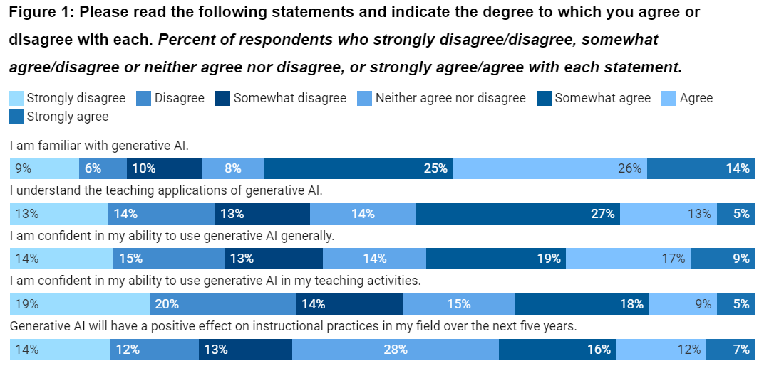
Ithaka S+R Generative AI and Postsecondary Instructional Practices
https://sr.ithaka.org/publications/generative-ai-and-postsecondary-instructional-practices
Notes:
Ellen
Ithaka S+R, which is a nonprofit helping academics and researchers use digital technologies to advance research and teaching, did a survey of instructors in 2024 to understand how instructors are (or are not) using generative AI in their classrooms. This is super important, because most college and university guidelines leave decision making about using generative AI up to the discretion of the instructors so it's important to know what they are feeling about AI. They had 2,654 responses, which is the largest survey to date about the use of AI for teaching purposes.
Here’s what they found:
The majority of instructors (65%) agree with the statement that they are familiar with generative AI, however the majority are not confident in their abilities to use them, or use them for pedagogical purposes.
They did find, though, that familiarity with AI is not necessarily associated with confidence in their ability to use it or with enthusiasm for it. One thing they did find, however, is that both familiarity and confidence are associated with younger generations of instructors.

Slide 7
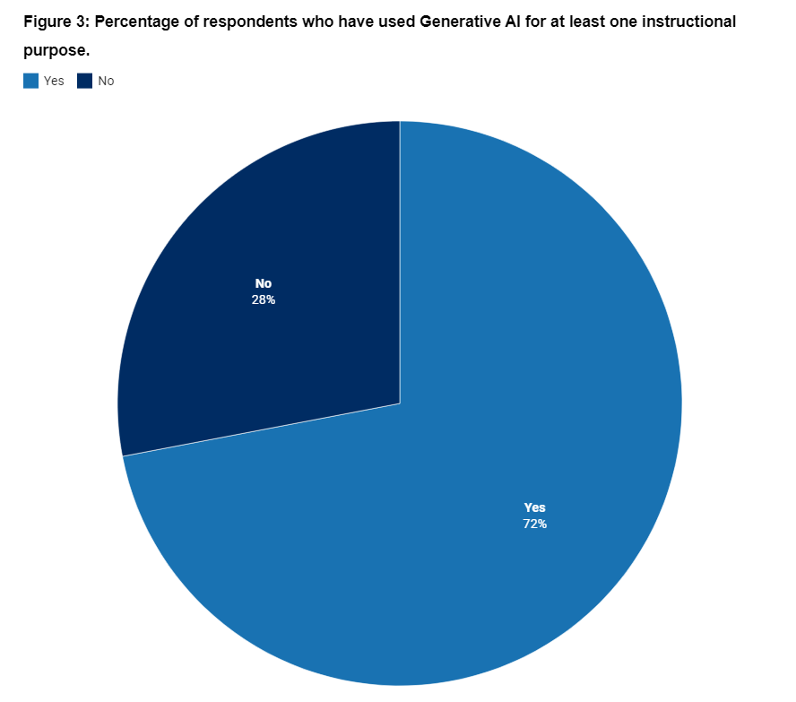
Ithaka S+R Generative AI and Postsecondary Instructional Practices
https://sr.ithaka.org/publications/generative-ai-and-postsecondary-instructional-practices
Notes:
Ellen
More findings - 72% of instructors reported have experimented with using generative AI as an instructional tool. BUT...

Slide 8
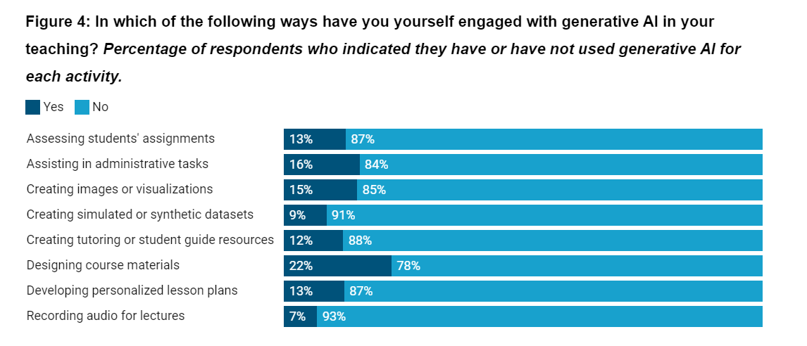
Ithaka S+R Generative AI and Postsecondary Instructional Practices
https://sr.ithaka.org/publications/generative-ai-and-postsecondary-instructional-practices
Notes:
Ellen
However, there’s not one particular use case for AI that is standing out. The use that got the highest was "creating course materials" - perhaps that shows that instructors are playing around with AI to help their workloads in these areas as a first step?
The survey indicated that in all of these kinds of areas, instructors want some kind of institutional support to help them integrate generative Ai into their courses - basically universities need to build out services to support a range of uses for AI.

Slide 9
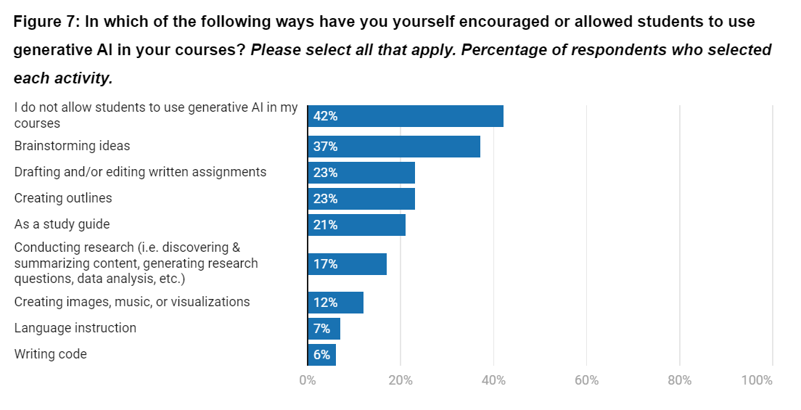
Ithaka S+R Generative AI and Postsecondary Instructional Practices
https://sr.ithaka.org/publications/generative-ai-and-postsecondary-instructional-practices
Notes:
Ellen
One more finding – 42% of instructors completely prohibit their students from using generative AI. I did some digging and found a survey from mid-2023 from an education consulting firm called Tyton Partners that found that in 2023, 46% of faculty did not allow generative AI at all. So that number has crept down a bit.
Tyton Partners study: https://tytonpartners.com/app/uploads/2023/10/GenAI-IN-HIGHER-EDUCATION-FALL-2023-UPDATE-TIME-FOR-CLASS-STUDY.pdf

Slide 10
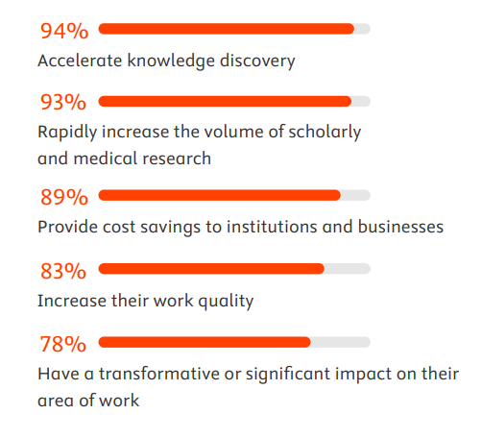
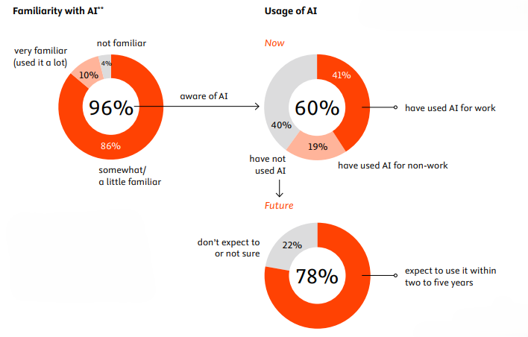
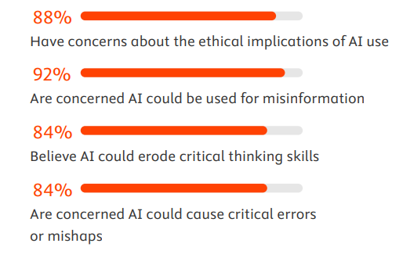
Elsevier Attitudes to AI Report: Librarian Key Findings
https://www.elsevier.com/insights/attitudes-toward-ai/librarians
Notes:
Ellen
This last study was one done by Elsevier in late 2023-early 2024. I’d encourage you to look at the overall report as well, but they’ve broken out focused analyses of academic leaders’, clinicians’ and industry’s attitudes, but they also have one for librarians, and that’s what we’ll look at here.
First of all, 96% of librarians have heard of generative AI, 60% have used it and 41% have used it for work purposes. 10% are very familiar and use it a lot.
Lack of time is unsurprisingly the biggest reason why people who have not used AI say they haven’t. But the vast majority of those who haven’t use it expect to do so soon!
Just like in that Educase study, librarians hold that duality of both positive and concern about AI.
You can see here the large majorities of librarians who think that AI will help accelerate knowledge discovery, increase research, provide cost savings, increase work quality, etc.
Yet, despite our positive attitudes, we are also very concerned about the ethical implications, misinformation, and the eroding of critical thinking skills.
I didn't include this graphic, but librarians also had lots of thoughts about what would increase our trust in AI tools – transparency about where and how AI is being used and transparency with AI citing where it gets its sources were at the top of the list.

Slide 11
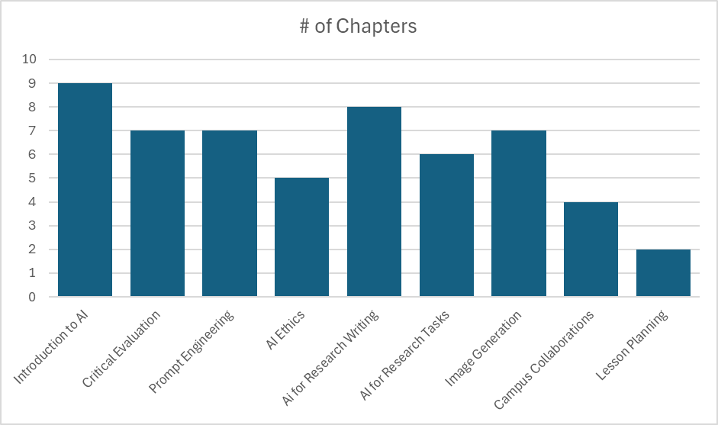
AI in Library Instruction: Trends
Forthcoming from ACRL:
AI and Library Instruction Cookbook
Notes:
Ellen
So now we want to switch gears and talk a little bit about the trends in library instruction and AI that we have seen through the process of editing the AI and Library Instruction Cookbook (in the ACRL instruction cookbook series, coming out in 2026!)
We have these sections in the book – Introduction to AI, Critical Evaluation, Prompt Engineering, AI Ethics, AI for Research Wriring, AI for Research Tasks, Image Generation, Campus Collaborations and Lesson Planning. You can see which categories have the most. Intro to AI and AI for Research Writing have the most, which I don't think is necessarily surprising. Now – it's also important to note that many of these recipe chapters encompassed more than one area. There are many in the Critical Evaluation or Prompt Engineering sections that also introduce AI, it's just that critical evaluation or prompt engineerings were a bigger part of the lesson. Also, many of the recipes in the image generation section also included aspects of critically evaluating AI image output.
I'd also like to note that we probably had more submissions in those first two areas – Intro to AI and Critical Evaluation – that we were able to accept.
We are going to take a look at the poll we took at the beginning of the session to see if this audience is doing similar things to the chapter authors, but before we do that, we'd like to give you a little sneak peek into what the book is going to offer.

Slide 12

AI in Library Instruction: Trends
Book Sneak Peek!
Notes:
Ellen
Introduction to AI: recipes that provide a framework for people to create sandboxes for people to play around with AI to learn about it, provides prompts for learning how to use it for humanities questions, introduction to Grounded vs. Non-grounded tools, embedding AI into an asynchronous course, introducing AI in teacher education, how to use it to help with executive functioning
Critical Evaluation: SIFT-ing and Lateral Reading, some specifically with health claims, or pop culture or recipes
Prompt Engineering: using the CLEAR Framework, using the CRISPE Framework, a homegrown "6 steps" framework, through the lens of travel advice
AI Ethics: AI and Transparency, AI and Copyright, AI and Authorship/Authority
AI for Research Writing: Framework for appropriateness in using AI in writing, applications and limitations, using AI for citation, using the PAIR Framework, how to prompt for different aspects of the writing process, how to use it ethically and critically, "Human in the Loop" vs. "Machine in the Loop"
AI for Research Tasks: Literature Reviews, Synthesis and Summarization, Web Scraping, creating protocols for animal research
Image Generation: Basics of visual literacy, evaluating misinformation, using AI for exhibits, Evaluting AI images with reverse searching, critical evaluation of AI images looking at the history of photo manipulation techniques
Campus Collaboration: creating an AI Literacy Hackathon on campus, creating a community of practice on your campus, collaborating with career services, collaborating with instructors to create AI policies for a class.
Lesson Planning: how to use AI to help plan library instruction

Slide 13

What are you doing with AI currently?
Notes:
Ellen
Review padlet

Slide 14
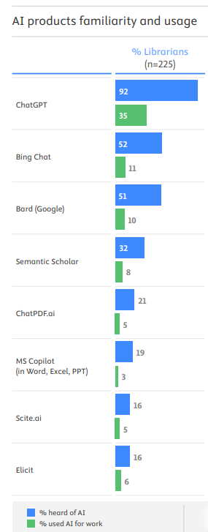
AI Tools in Library Instruction
Institutional Purchases:
Scopus AI
Primo Research Assistant
Microsoft Copilot
Box AI/Box Hubs
Tools we tend to teach:
Scopus AI
Elicit.com
Notes:
Ellen
Elsevier's survey indicated that these are the Gen AI products that librarians are most familiar with and use most often. I think that both anecdotally and through that survey just now we can see that's changed a lot.
In our circumstances at Baylor we have tools that our institution has purchased, namely Scopus AI (we trialed the AI tools from both Scopus and Web of Science and went with Scopus), and are beta testing the Primo Research Assistant. Our IT has also purchased Microsoft Copilot (we are a Microsoft campus) and the AI tools for Box cloud storage.
However, incidentally, the tools that we are most likely to teach in classes are Scopus AI and Elicit.

Slide 15

Overcoming Barriers: Faculty Integration
Two recent studies to explore:
  Mah, D.-K., & Groß, N. (2024). Artificial intelligence in higher education: Exploring faculty use, self-efficacy, distinct profiles, and professional development needs. International Journal of Educational Technology in Higher Education, 21(1), 58. https://doi.org/10.1186/s41239-024-00490-1
  Richardson, E., Gordon, J., Conklin, S., Barreto, D., & Ginnetti, R. (2024). Artificial Intelligence in Higher Education: Faculty Perceptions of Integration and Other Considerations. UNC System Learning and Technology Journal, 2(1), Article 1. https://journals.charlotte.edu/ltj/article/view/1776
ThePhoto by PhotoAuthor is licensed under CCYYSA.
Notes:
Amy
There are two studies that I want to highlight here when we are thinking about barriers because one major barrier is going to be faculty integration or lack of integration of AI tools.
Both of these studies dive into how faculty in higher education are thinking about AI—its potential, its challenges, and what kind of support they need to use it effectively.
The first study surveyed 122 faculty members to get a sense of how confident they feel using AI (self-efficacy), what benefits they see, and what obstacles they face. One of the biggest positives they pointed out was AI’s potential to increase equity in education. But on the flip side, a major issue is that both faculty and students often lack AI literacy, making it hard to use the technology effectively. That’s why most respondents said they’re eager for professional development opportunities focused on AI. The takeaway? Colleges and universities need to provide targeted training and foster discussions around AI to help faculty integrate it thoughtfully into their teaching and research.
The second study, published in the UNC System Learning and Technology Journal, also looks at faculty perspectives but broadens the discussion to include ethical considerations and policy development. Faculty recognize AI’s potential to personalize learning and streamline administrative tasks, but they also worry about data privacy, ethics, and the digital divide. Like the first study, this one highlights the need for strong professional development and institutional support. It also emphasizes the importance of clear policies and resources to ensure AI is implemented responsibly and equitably.
Together, these studies paint a picture of a higher ed landscape that’s eager to embrace AI but needs guidance, training, and ethical safeguards to do it well.

Slide 16
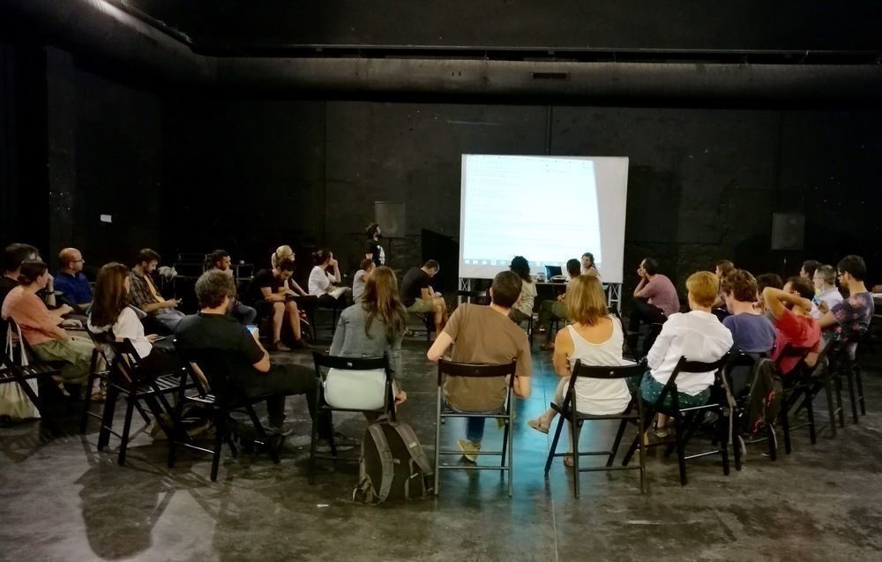
Faculty Training
Self-paced Canvas course open to all covering Gen AI (5 modules)
Department meeting discussions
Department level trainings
ThePhoto by PhotoAuthor is licensed under CCYYSA.
Notes:
Amy
I have developed a self-paced Canvas course on gen ai literacy that covers five major areas. The first four are based off of University of Arizona’s AI literacy tutorials which are creative commons licensed for reuse/remixing.
What is generative ai?
The technology behind chatgpt
How does chatgpt prevent harmful use?
Using chatgpt effectively
Ai and ethics
The course is open on canvas for anyone to view—even if you're not at baylor.
I have attended some department meetings and talked about AI, ethics, implications, and use in research and teaching. The ability to get in front of faculty to talk about these things is KEY!
I have also been part of leading a series of workshops for our EdD and online graduate programs on AI. I led the first two in a series of 6 workshops for that group. The first was more introductory. The second was focused on AI for research, where I shared things like Elicit, Research Rabbit and LitMaps. My colleague and our Director of Data and Digital Scholarship joined me to share about AI for data analysis.
In fact just this afternoon Ellen and I are going to be talking with the School of Social Work Faculty along with some of our colleagues about AI basics and research.
So, at Baylor, we are really making an effort to help faculty understand and use AI so that they can help their students understand and use AI in ways that will help them as they enter into the world outside of Baylor.

Slide 17
Ethical Considerations and Responsible AI Use
Academic Integrity
Bias
Privacy
Transparency
Notes:
Amy—
AI is changing the way we do research and teach in higher education, and while it has some incredible benefits, it also raises big ethical concerns.
Academic integrity
With tools like ChatGPT and other AI writing assistants, students can generate essays, summaries, and even research papers in seconds. The challenge is figuring out where the line is between legitimate AI use—like brainstorming ideas or improving writing—and outright cheating. If students rely on AI to do the thinking for them, they’re not actually learning. And when AI starts fabricating sources or misrepresenting information, it becomes an even bigger problem.
Bias
AI is trained on existing data, which means it can reinforce stereotypes or inaccuracies. If students aren’t critically evaluating AI-generated content, they might take biased or misleading information at face value. That’s why teaching information literacy—especially how to fact-check AI-generated content—is more important than ever.
Privacy
A lot of AI tools collect data on users, and students may not realize that what they type into an AI chatbot could be stored or even used to train future models. Institutions need to set clear policies so students (and faculty) know how their data is being used.
At the end of the day, AI isn’t going away. As librarians, our job is NOT to endorse or deny artificial intelligence use in teaching and research. It is our job to ensure students and faculty are aware of these ethical considerations and are able to use it critically and responsibly. If we can integrate AI into research and learning in ethical, transparent ways, we’ll be preparing students not just for academic success, but for a world where AI is a part of everyday life.
Transparency
If students are using AI in their work, they need to be upfront about it—just like they would cite any other source. But that means we, as educators and librarians, also need to have clear guidelines on what responsible AI use looks like. Some schools are embracing AI and teaching students how to use it ethically, while others are trying to ban it outright, which—let’s be honest—probably isn’t realistic.

Slide 18
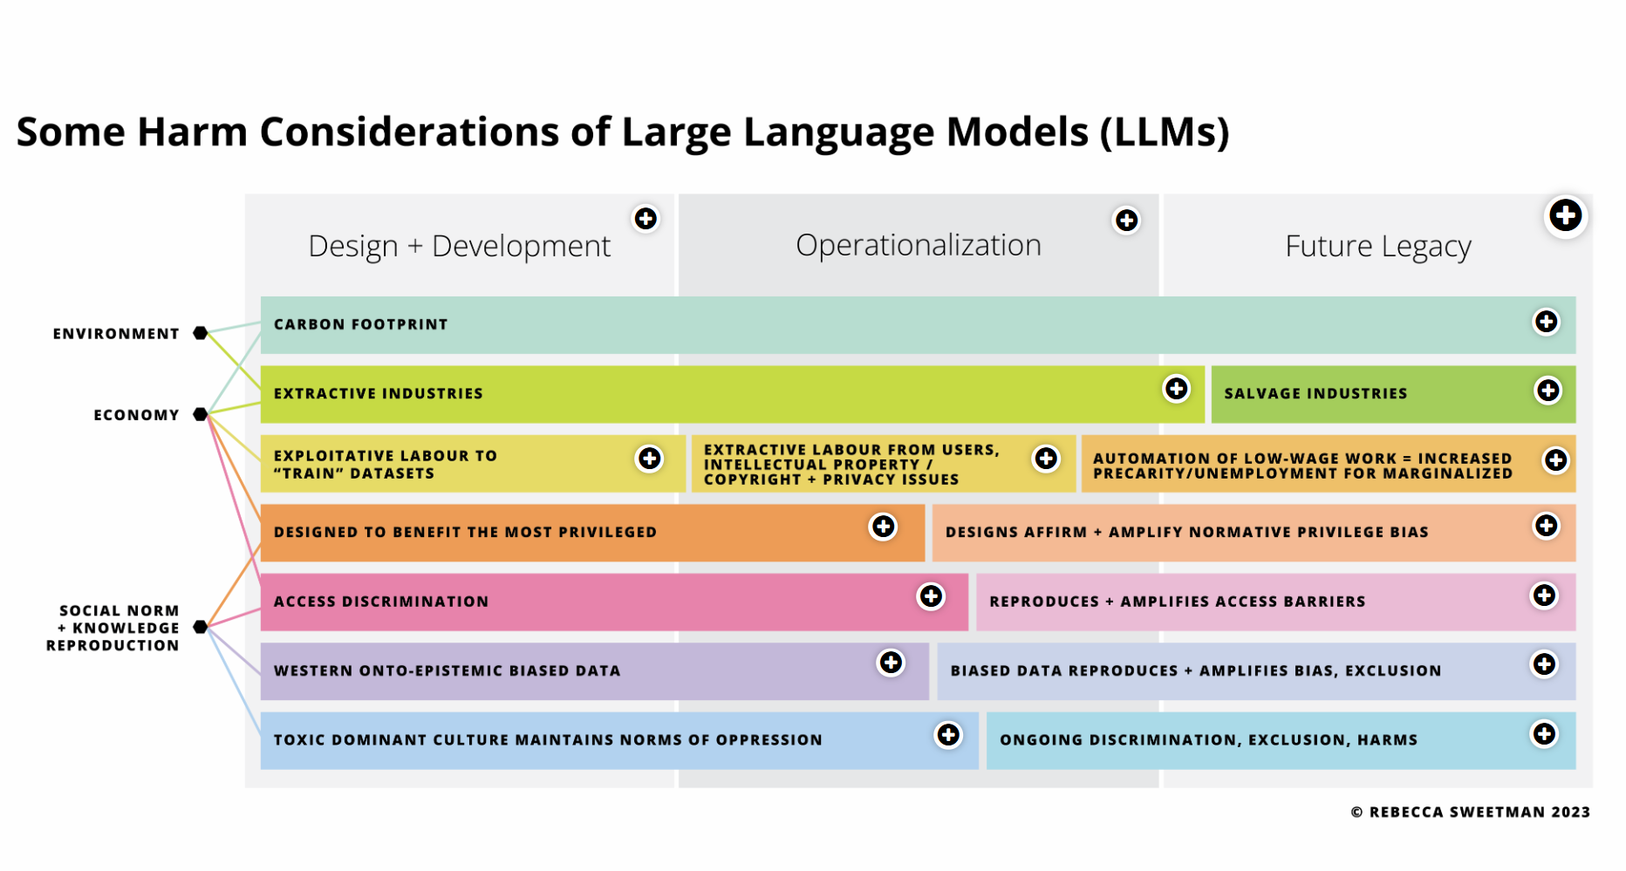
Some Harm Considerations of LLMs
Notes:
https://h5pstudio.ecampusontario.ca/content/51741
Click to go through and review
"Some Harm Considerations of Large Language Models (LLMs)," is an interactive resource created by Rebecca Sweetman, Associate Director of Educational Technologies at Queen’s University. Hosted on the eCampusOntario H5P Studio platform, this resource employs an "Image Hotspots" format to explore various potential harms associated with LLMs.

Slide 19
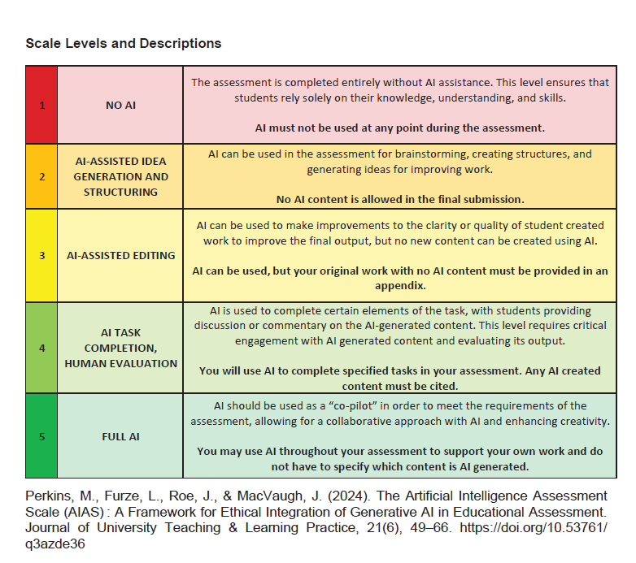
Rubrics
Notes:
Amy
Students may have a difficult time understanding what is allowed and what isn’t so it’s important that faculty are clear. This scale was developed with a focus on academic integrity and cheating. But, it helps student to see to what extent they are able to use ai on any given assignment. There is a gradient of allowable use.

Slide 20
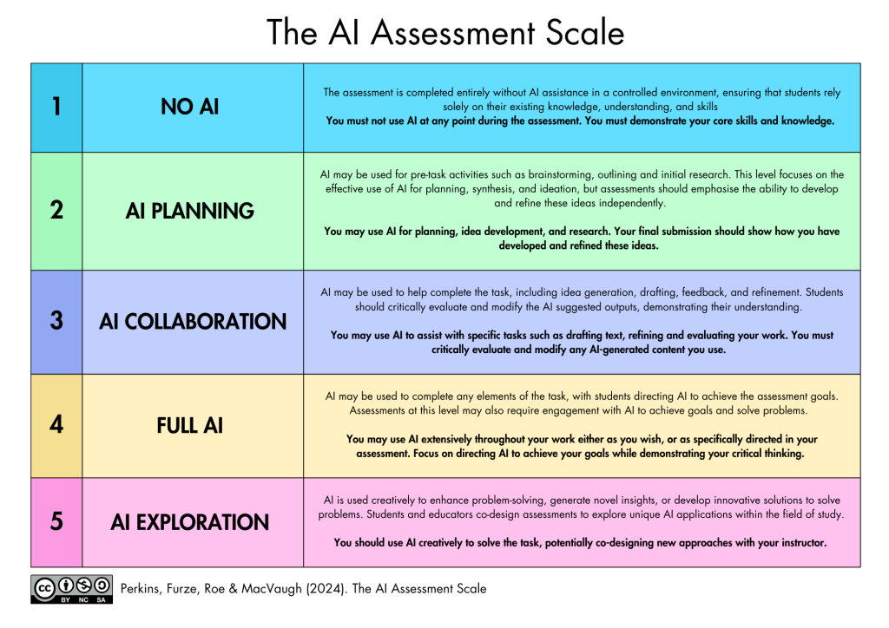
Rubrics
Notes:
Amy
Here is the updated version by Perkins, Furze, Roe and McVaugh and this one has more of a focus on assessment of ai going all the way up to AI exploration where you can use AI creatively to solve the task potentially co designing new approaches with an instructor. Again, there is a gradient of allowable use. But these are just two options that faculty might choose – or they might create their own version of a rubric to make sure that they are clear with students on what is allowed and what is not allowed.

Slide 21
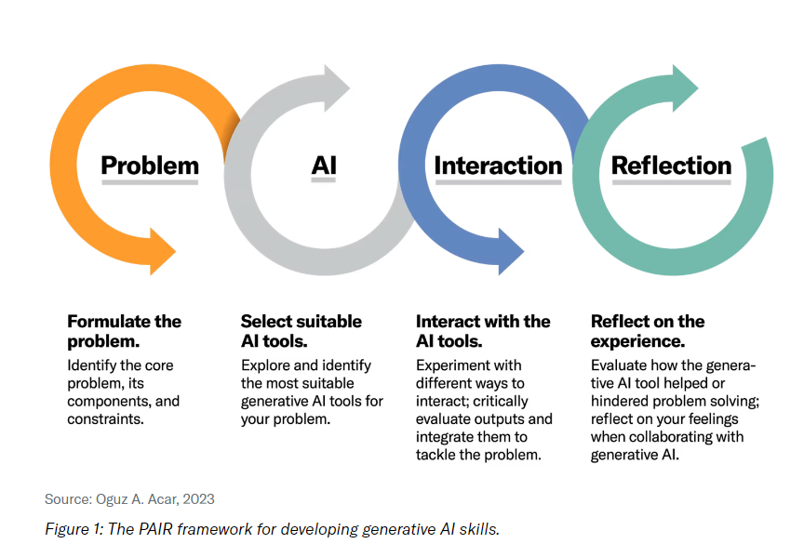
PAIR FRAMEWORK
Notes:
Oguz A Acar (from King's College London—chair of marketing at the business school) published an article in Harvard Business Publishing—Education in 2023 where he talks about how instead of opting for defensive stances or banning tools like ChatGPT and other generative ai tools because of fears surrounding academic dishonesty, inaccuracies, bias, and proliferation of harmful content, we should "empower students to harness" these tools. Acar has done much research around the psychology of AI and student learning and from that research, he defined five key skills that students need to harness in order to effectively use AI. So, after looking at these key skills that students need to know, Acar came up with a framework to help students target and improve these skills. He came up with the PAIR framework.
PAIR consists of 4 steps:
Problem formulation: students define the problem or challenge they want to solve.
AI Tool selection: students choose the best gen ai tools to help them with their problem. They learn how to explore, compare, and evaluate different gen ai tools and their features.
Interaction: students use the gen ai tools to solve their problem. They experiment with different inputs and outputs and see how the gen ai tools affect their problem solving process and outcome.
Reflection: students assess and report their experiences with the generative AI tools.
This last piece –the R for REFLECTION is *I think* the most important part. Whenever we have students engage with an AI tool they NEED to be reflecting on their experience with it.
Also, before implementing the PAIR framework, it's important to make sure that the faculty that you're working with are on board with it. Also, be sure that the assignments align with the students' prior knowledge of AI. And, design assignments that are compatible with free tools, or those already included in your institution's subscriptions, to ensure accessibility and promote an inclusive environment.
Citing https://hbsp.harvard.edu/inspiring-minds/are-your-students-ready-for-ai for this page.

Slide 22

Discussion & Next Steps
Actionable Takeaways:
How to begin incorporating AI into your library instruction now:
  Communicate with instructors
  Start small (focus on critical use—rather than use of multiple tools)
How to stay current and keep learning:
  Be sure to read our upcoming book (The AI & Library Instruction Cookbook, ACRL publications)
  There’s an AI for that (aggregator) https://theresanaiforthat.com/
  Follow your favorite information literacy journals (i.e. Communications in Information Literacy). It’s a hot topic!
Consider ethical implications & best practices
  Some Harm Considerations of LLMs:
  https://h5pstudio.ecampusontario.ca/content/51741
Notes:
Amy
Actionable takeaways:
One way you can start incorporating AI in your instruction
How to continue learning about AI and staying informed
Consider ethical implications and best practices for integrating generative AI into instruction

Slide 23
Workshop Resources
https://libguides.baylor.edu/infolit/ailiteracy
Notes:
Handout with key AI concepts and tool comparisons
List of AI literacy resources for librarians
Links to AI policy discussions and instructional design strategies

Slide 24

Q&A
Contact Information:
Amy_b_james@baylor.edu
Ellen_Filgo@baylor.edu
Notes:
Open discussion:
What are your biggest challenges or successes with AI in library instruction?

